Slide 1
Anesthesia for burn patients
By Wubayehu Amare (MSc, lecturer Anesthesia department, CHS, AAU)

Slide 2
outline
Introduction
objectives
Overview of skin anatomy
Epidemiology and etiology of burn
Types of burn injury
Classification of Burn injury
Management of burn injury
complications after burn

Slide 3
Objectives
At the end of this presentation (discussion), you will be able to:
Define a burn injury
Explain types of burn
Describe classification of burn injury
Elaborate on management of burn injuries

Slide 4
Introduction
Burn injury of the skin is characterized by the damage to skin tissue from hot (scald, flash, flame, contact), cold, electrical, chemical, radiation, sunlight, or other sources.
Burns constitute one of the most common causes of morbidity and mortality worldwide.
They can result in significant disfigurement, physical impairment, work loss, psychological problems, andconsiderable economic burden.

Slide 5
Cont..
The severity of a burn injury largely depends on :
The temperature
Duration of exposure to the harmful agent, as well as the area of the body affected.
Burns causes significant injury at the local burn site as well as a systemic response throughout the body

Slide 6
Cont..
All patients who present with burn injuries should be thoroughly evaluated using the Advanced Trauma Life Support (ATLS) protocol.
Approximately 10 % of patients with burn injuries also present with concomitant traumatic injuries, so a head to toe evaluation is imperative.
An ABCDEF primary survey should be performed: airway, breathing, circulation, disability, exposure, and fluid resuscitation

Slide 7
Anatomy of the Skin
The skin is the body's largest organ, covering an average of 2 square meters in adults.
It acts as a protective barrier against environmental threats like pathogens, chemicals, and physical injury.
The skin also plays a critical role in thermoregulation, sensation, excretion, and vitamin D synthesis.

Slide 8
Structure of the Skin
The skin consists of three primary layers:
Epidermis (Outermost Layer)
Dermis (Middle Layer)
Hypodermis (Subcutaneous Layer)
It is important to understand the layers of our skin so that we can understand how healing occurs differently based on depth

Slide 9
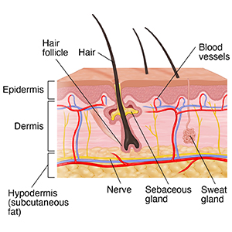

Slide 10
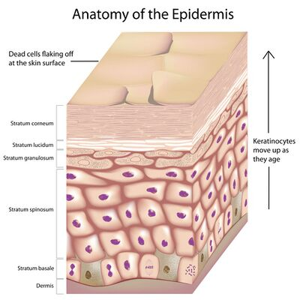
The Epidermis
The epidermis is the outermost layer of skin, providing the first line of defense against external threats.
It is thin (about 0.1 mm), but highly protective
Its thickness varies based on location.
For example, it is thickest on the heels and thinnest on the eyelids.
Areas that have increased use from friction or weight bearing can build up thicker layers of skin (e.g., where a pencil rubs your writing finger or shoe rubs against your foot).

Slide 11
Cont..
Composed of five layers and is avascular
It has no nerves, but free nerve endings from the dermis do extend into the mid layers of the epidermis.
Composition:
Keratinocytes: The primary cells in the epidermis, producing keratin, a tough protein that helps waterproof the skin.
Melanocytes: Cells located in the basal layer of the epidermis that produce melanin, the pigment responsible for skin color and protection against UV radiation.

Slide 12
Cont..
Langerhans cells: Part of the immune system, these cells help protect against pathogens.
Merkel cells: Sensory cells that help detect light touch and pressure.
Functions:
Protects against mechanical injury, pathogens, and water loss.
Provides skin pigmentation and UV protection.
Regulates immune responses through Langerhans cells.

Slide 13
the Dermis
Located beneath the epidermis, the dermis is thicker and consists of connective tissue.
It supports and nourishes the epidermis while providing the skin with strength and elasticity.
Contains blood vessels and nerves which supply the epidermis via capillary loops and free nerve endings

Slide 14
Cont..
Composition:
Collagen fibers: The main structural protein in the dermis, providing strength and support.
Elastin fibers: Allow the skin to return to its original shape after stretching, providing flexibility.
Fibroblasts: Cells responsible for synthesizing collagen and elastin.
Blood vessels: Supply nutrients to the skin and remove waste.
Hair follicles: Produce hair, with associated sebaceous glands secreting oil.
Sweat glands: Secrete sweat to regulate temperature and excrete waste products.
Sebaceous glands: Produce sebum (oil) that keeps the skin moisturized and protects it from microbial invasion.

Slide 15
Cont..
Layers of the Dermis:
Papillary dermis:
The thin upper layer, containing small blood vessels and sensory neurons.
It forms dermal papillae that interlock with the epidermis.
Reticular dermis:
The thicker, deeper part of the dermis, containing larger blood vessels, nerves, and more collagen fibers.
This layer gives the skin its strength and elasticity.

Slide 16
Cont..
Functions:
Provides structural support for the epidermis.
Houses blood vessels, hair follicles, and glands that regulate body functions.
Facilitates sensation through nerve endings (e.g., pain, touch, pressure).
Plays a role in thermoregulation (blood vessels constrict/dilate to manage temperature).

Slide 17
The Hypodermis
Located below the dermis and contains subcutaneous tissue.
It is made up of loose connective tissue, adipose tissue. It is well vascularised and well innervated.
It helps to attach the skin to the muscles and bones through superficial fascia, and provides insulation and cushioning through fat storage.

Slide 18
Cont..
Composition:
Adipose tissue (fat): Stores energy and acts as an insulator to help regulate body temperature.
Connective tissue: Attaches the skin to underlying structures such as muscles and bones.
Blood vessels and nerves: Provide nourishment and sensation to the skin.
Functions:
Insulates the body, helping to retain heat.
Acts as a shock absorber to protect deeper structures.
Serves as an energy reservoir by storing fat.
Provides flexibility and mobility by allowing the skin to move independently of underlying structures.

Slide 19
Function of the skin
1. Protection:
Barrier function: The skin acts as a physical barrier against mechanical injury, pathogens, and harmful chemicals.
UV protection: Melanin in the epidermis absorbs UV radiation, reducing the risk of skin damage and cancer.
2. Sensation:
The skin contains numerous nerve endings that detect stimuli such as pain, pressure, touch, and temperature, helping us interact with our environment.

Slide 20
Cont..
3. Thermoregulation:
Sweat glands and blood vessels in the dermis help regulate body temperature through cooling (via sweating) and warming (via vasoconstriction).
4. Excretion:
Sweat glands help excrete waste products, including salts, urea, and other metabolites, through perspiration.
5. Vitamin D Synthesis:
The skin synthesizes vitamin D when exposed to UVB light, which is essential for calcium absorption and bone health.

Slide 21
Epidemiology of burn
Burns are a leading cause of global morbidity and mortality:
Approximately 180,000 deaths annually worldwide due to burns (WHO).
The majority of fatalities occur in low- and middle-income countries (LMICs), with sub-Saharan Africa, Southeast Asia, and the Eastern Mediterranean facing the highest rates.
Global Incidence:
Burns account for around 5 million cases of injury per year.

Slide 22
Cont…
Among these, 1-2 million individuals experience severe burns requiring medical intervention.
Age Group Most Affected:
Children and young adults (especially those under 5 years of age) are at significant risk.
Elderly individuals are also highly vulnerable due to pre-existing health conditions.

Slide 23
Cont..
High-Risk Populations
Children:
Curiosity and play near hazardous objects (open flames, cooking stoves, hot water).
Burns are the 3rd leading cause of childhood injury-related death globally.
Elderly:
Aging skin is thinner and more fragile, leading to higher severity burns.

Slide 24
Cont…
Reduced ability to recover from burns due to pre-existing conditions (e.g., diabetes, cardiovascular diseases).
Low-income Populations:
Rural areas often use open flames for cooking, making them more vulnerable.
Inadequate infrastructure leads to poor safety standards and delayed medical care.

Slide 25
Cont..
Global burn death rate is approximately 10% in developed nations, but can be as high as 40-50% in LMICs due to delayed medical treatment and poor infrastructure.
Burns are a significant public health issue in Ethiopia:
A study in Addis Ababa found that 5-10% of all trauma cases in major hospitals were burn-related.
Mortality Rates:
Burn injuries are one of the leading causes of death among trauma patients in Ethiopia.

Slide 26
Cont..
Limited access to specialized care exacerbates the mortality rate.
High Prevalence in Rural Areas:
Traditional cooking methods, such as the use of open flames (kerosene lamps and stoves) and firewood for cooking, increase the risk of burns.
Unprotected electrical connections and poor building materials contribute to fire accidents.

Slide 27
etiology of burn injuries
Burn injuries can arise from a wide range of causes, each contributing to the severity and type of burn sustained.
The etiology, or origin, of burns can be categorized into various mechanisms. including :-
Thermal (flames, scalds, contact),
Electricity,
Chemicals, or
Sunlight.

Slide 28
1. thermal burns
Causes:
Flame Burns, Scalds (Hot Liquids),Hot Objects.
1. Flame Burns
Cause: Direct contact with flames or fire sources (e.g., house fires, car accidents, industrial incidents, or explosions).
Prevalence: Flame burns are one of the most common causes of burn injuries.

Slide 29
Cont..
Mechanism: Flames cause intense heat that can quickly damage skin and underlying tissues, leading to first, second, or third-degree burns depending on the exposure time and temperature.
Age Group: More common in adults and children, especially in situations like household fires or occupational accidents.
2. Scald Burns
Cause: Burns from hot liquids or steam (e.g., hot water, coffee, tea, or cooking oil).

Slide 30
Cont..
Mechanism: Scalds result from the rapid transfer of heat from liquids or steam, which cause immediate tissue damage. The burn severity depends on the temperature and the duration of exposure.
Prevalence: Scald injuries are common, especially in children and elderly
Age Group:
Children (especially under 5 years) are at the highest risk for scald burns due to curiosity and their lower ability to escape from danger.

Slide 31
Cont…
Adults and Elderly: While scald burns are also common in adults, the elderly are particularly vulnerable due to impaired mobility and slower reflexes
3. Contact Burns
Cause: Direct contact with hot surfaces or objects (e.g., stoves, irons, hot appliances, or radiators).
Prevalence: Contact burns are relatively common, especially in the home environment or workplaces (e.g., kitchen, industrial settings).

Slide 32
Cont..
Mechanism: Contact burns occur when the skin touches a hot object for a prolonged period, causing localized damage. The depth of the burn depends on the temperature of the object and the contact duration.
Age Group: Both children (due to their curiosity) and adults (due to accidents in daily activities) are susceptible.
Elderly: Older individuals may experience contact burns more frequently due to limited mobility and slower response times.

Slide 33
2. Electrical Burns
Cause: Exposure to electric current, either from direct contact with electrical sources or from lightning strikes.
Mechanism: Electrical burns occur when an electric current passes through the body, causing heat generation within tissues and resulting in severe damage.
It can cause deep tissue injury, cardiac arrhythmias, and internal organ damage.

Slide 34
Cont..
Prevalence: Electrical burns are less common but can be severe and life-threatening.
Age Group: More common in adults who work with electrical equipment, but children may be at risk from household electrical outlets or wires.
Workplace Risk: High-risk professions, including electricians, construction workers, and people working in power plants, have a higher incidence of electrical burns.

Slide 35
3. Chemical burns
Cause: Exposure to corrosive chemicals like acids or alkalis (e.g., sulfuric acid, bleach, ammonia).
Mechanism: Chemical burns occur when chemicals come into contact with skin or mucous membranes, causing tissue damage through chemical reactions.
Acids typically cause a sharp burn, while alkalis can cause more severe damage due to deeper tissue penetration.

Slide 36
Cont..
Prevalence: Less frequent compared to thermal burns, but significant in industrial, laboratory, or household settings.
Age Group: Both adults and children are at risk, especially with improper storage or handling of chemicals in the home or workplace.
Workplace Risk: Industries such as manufacturing, agriculture, or cleaning chemicals are at increased risk for chemical burns.

Slide 37
4. Radiation burns
Causes:
UV Radiation (Sunburns): Overexposure to ultraviolet radiation from the sun or artificial tanning beds.
Ionizing Radiation: Burns from medical treatments like X-rays or radiation therapy, or from accidental exposure to radioactive materials.
Age Considerations:
Children & Adolescents: More sensitive to UV radiation, leading to severe sunburns, particularly in outdoor activities.

Slide 38
Cont….
Adults: Risk of radiation burns from occupational exposure (e.g., healthcare workers, nuclear industry).
Elderly: Cumulative damage from years of sun exposure, leading to chronic skin damage and increased risk of skin cancer.

Slide 39
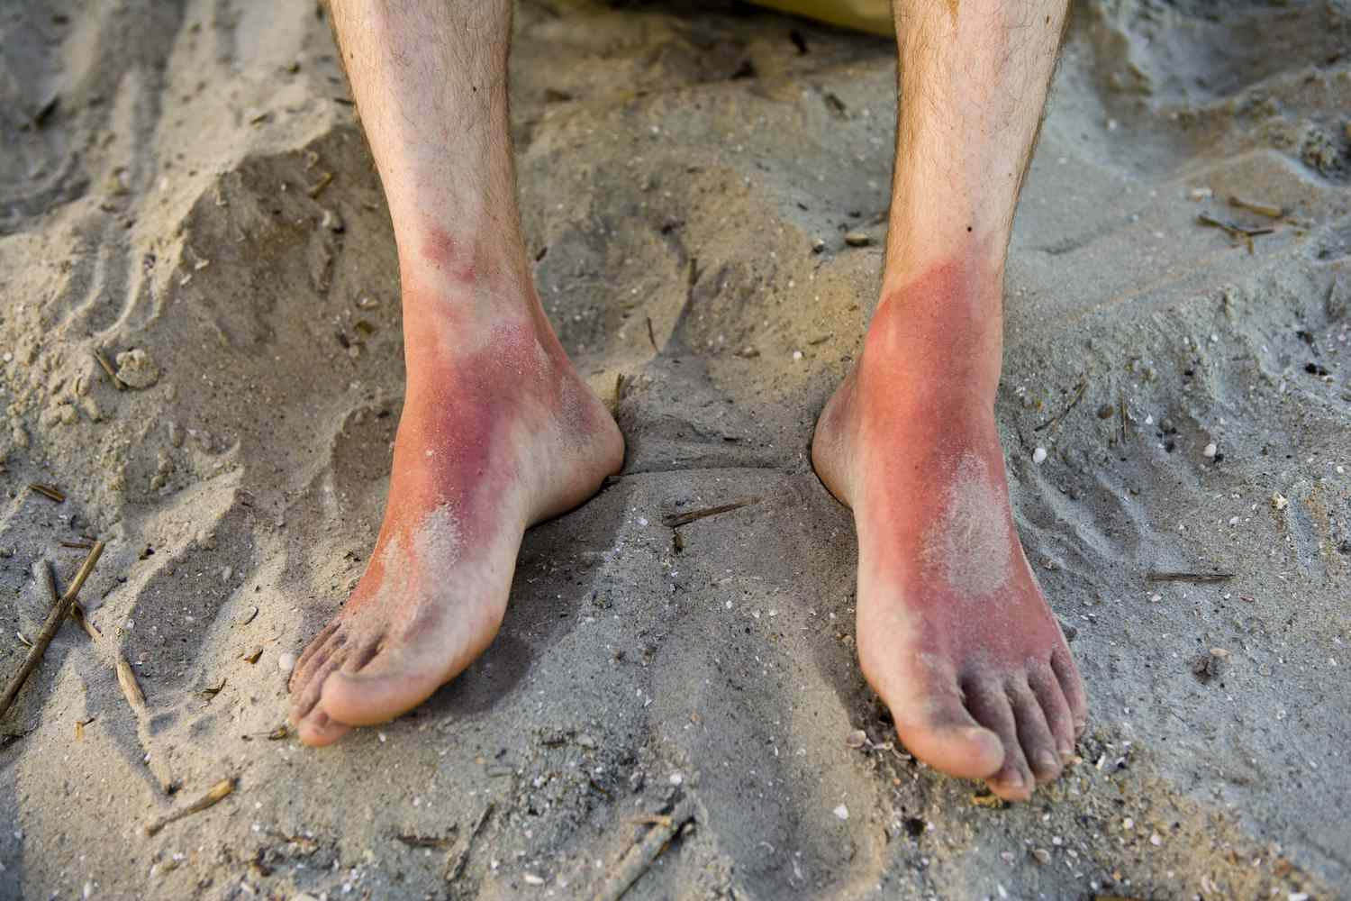
Types of Burns
1. First-Degree Burn (Superficial Burn)
Affects only the outer layer of the skin (epidermis).
Characterized by redness, pain, and minor swelling.
Skin may peel after a few days.
Symptoms:
Red, painful skin.
Dry, no blisters.
Healing time: 3-5 days.
Examples:
Sunburn, Mild scalds from hot objects or liquids.

Slide 40
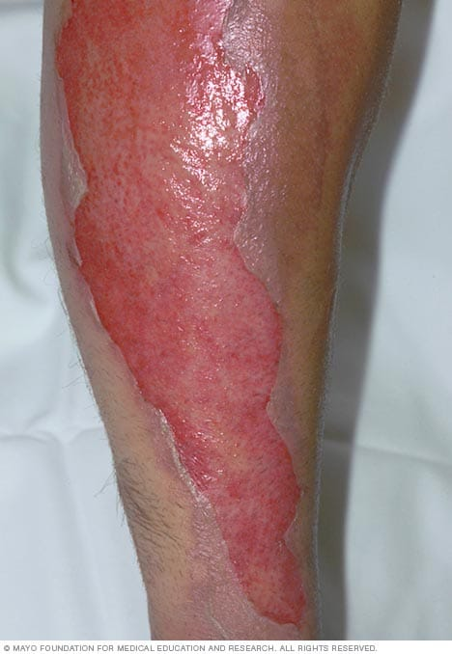
Cont…
2. Second-Degree Burn (Partial Thickness Burn)
Affects both the outer layer (epidermis) and the layer underneath (dermis).
Causes swelling, redness, and blisters.
Can be more painful than first-degree burns.
Symptoms:
Red, blistered skin.
Painful with swelling.
Healing time: 2-3 weeks, can leave scars.
Examples:
Contact with hot water, steam, or a flame.
Contact with chemicals or electrical sources.

Slide 41
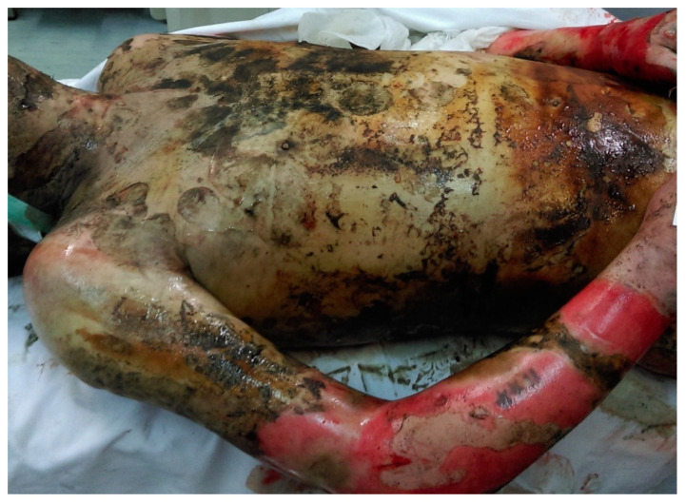
Cont..
3. Third-Degree Burn (Full Thickness Burn)
Extends through all layers of the skin, affecting deeper tissues (fat, muscle, bone).
Skin may appear white, charred, or leathery.
Nerve damage may cause no pain, though surrounding areas may still hurt.
Symptoms:
Skin may be blackened or white.
May have a leathery texture.
Loss of sensation in the affected area.
Examples:
Prolonged contact with fire.
Serious electrical burns.
Deep chemical burns.

Slide 42
Cont..
4. Fourth-Degree Burn
Involves damage beyond the skin, including muscles, tendons, and bones.
The tissue may be charred or completely destroyed.
Often requires complex treatment and can result in permanent disability.
Symptoms:
Skin, fat, muscle, and bone destruction.
Blackened and charred appearance.
Requires immediate medical intervention.
Examples:
Extensive fire damage.
Severe electrical burns.
Industrial accidents.

Slide 43
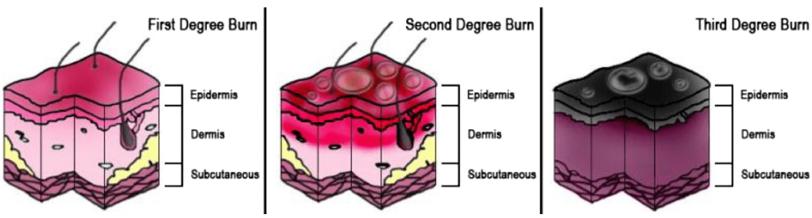

Slide 44
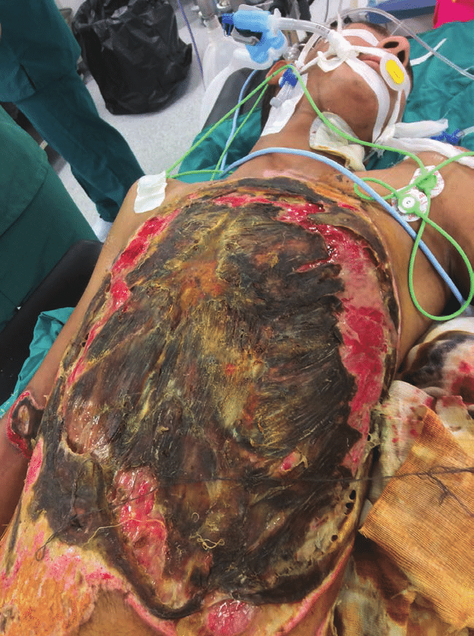

Slide 45
Pathophysiology of burn injury
Local effects of burn injuries
Burn injuries cause severe tissue damage due to the destruction of the skin and underlying tissues.
The skin, being a protective barrier, plays a crucial role in limiting the extent of the damage, but the severity depends on the temperature, energy of the burn agent, and the duration of exposure.
A burn injury site can be divided into three distinct zones, each representing varying levels of damage:

Slide 46
Cont..
1. Zone of Coagulation (Necrosis Zone):
This is the central area of the burn, where tissue is irreversibly damaged.
Characteristics:
Irreversible tissue death (necrosis).
Immediate coagulation of proteins and cells.
Loss of tissue integrity.
Most severe damage occurs in this area.

Slide 47
Cont..
2. Zone of Stasis (Impaired Perfusion Zone):
Surrounds the coagulation zone and contains tissue that is at risk of further damage.
Characteristics:
Moderate damage to tissues.
Presence of vascular transudate (fluid leakage) and inflammatory factors like vasoconstricting agents.
Impaired tissue perfusion, leading to reduced oxygen and nutrient delivery.
Potential for recovery or progression to necrosis depending on wound environment (i.e., infection, oxygen supply, etc.).

Slide 48
Cont…
3. Zone of Hyperaemia (Increased Blood Flow Zone):
The outermost zone, where the tissue is inflamed but not yet necrotic.
Characteristics:
Increased blood flow to the affected area due to vasodilation caused by inflammation.
No significant risk of necrosis unless there are complications like severe sepsis or prolonged hypoperfusion (low blood flow).
Good chance for recovery if proper treatment is given.

Slide 49
Systemic Effects of Burn Injuries
Burn injuries, especially those involving more than 30% of total body surface area (TBSA), trigger complex systemic effects due to the body's response to the trauma.
1. Burn Shock and Cardiovascular Dysfunction
Burn shock occurs when burns affect a large portion of the body (over 30% TBSA), leading to hypovolemia (a reduced volume of blood) and the release of inflammatory mediators.

Slide 50
Cont..
These factors combine to impair circulation, reducing blood flow to vital organs and tissues.
This state is irreversible despite prompt intervention.
The increase in systemic vascular resistance (SVR) and the resulting decrease in cardiac output are hallmarks of this phase.
Even with adequate fluid resuscitation, myocardial depression, pulmonary and vascular resistance remain elevated, contributing to organ failure and worsened outcomes.

Slide 51
Cont…
2. Plasma Extravasation and Oedema Formation
Plasma extravasation is the leakage of plasma proteins from blood vessels into surrounding tissues.
This leads to oedema (swelling), which occurs due to fluid buildup in both burned and unaffected tissues.
The oedema process is biphasic:
Phase 1 (immediate) begins within the first hour after the burn injury, involving rapid fluid accumulation.

Slide 52
Cont..
Phase 2 (delayed) happens between 12-24 hours after injury, with more gradual fluid retention in the tissue.
Fluid resuscitation can exacerbate oedema due to increased capillary pressure, but in the absence of fluids, oedema is more self-limiting.

Slide 53
Cont..
3. Cellular Depolarisation and Tissue Damage
Severe burns lead to cell membrane depolarisation in not just the burned tissue, but also in distant tissues like skeletal muscle.
This change in membrane potential (from −90mV to more positive values) increases water and sodium content in cells, resulting in cellular oedema.
This is thought to be caused by increased membrane permeability to sodium, and a decrease in ATP production and ATPase activity, making it harder for cells to maintain normal function.

Slide 54
Cont…
4. Hypermetabolism and Energy Demand
Hypermetabolism is a prominent feature in burn patients, where resting energy expenditure can double in cases of burns affecting over 40% of TBSA.
This elevated metabolic state persists for months, even after wound healing.
The body's response includes increased production of stress hormones (catecholamines, cortisol, glucagon), and pro-inflammatory cytokines like interleukin 6 (IL-6) and tumor necrosis factor (TNF).
This results in muscle wasting, impaired wound healing, immune dysfunction, and delayed rehabilitation.

Slide 55
Cont….
5. Hormonal and Endocrine Disruptions
Burns cause significant changes in the endocrine system.
Initially, there's an increase in stress hormones (cortisol, catecholamines, glucagon), which drive the catabolic response, leading to protein breakdown, hyperglycemia, and loss of muscle mass.
Alterations in thyroid hormones and the growth hormone (GH)-insulin-like growth factor (IGF-1) axis are seen in burn patients.
In particular, IGF-1 levels, which play a critical role in tissue growth and repair, are suppressed.

Slide 56
Cont…
6. Glucose Metabolism Disruptions
The body’s glucose metabolism is severely altered, with hyperglycemia being common, as the body switches to gluconeogenesis (producing glucose from non-carbohydrate sources like amino acids).
Increased glucose production, coupled with reduced insulin sensitivity, leads to insulin resistance.
The body may produce excess glucose but is unable to effectively utilize it, leading to persistent high blood glucose levels.

Slide 57
Cont…
7. Cardiac and Renal Dysfunction
Cardiac function is impaired due to the effects of burn shock.
Initially, cardiac output decreases, but after a few days, the heart works harder to compensate for the shock, increasing the cardiac workload and oxygen consumption.
Renal dysfunction follows from impaired circulation, with a reduced glomerular filtration rate (GFR) and hypovolemia, leading to conditions like oliguria and potentially acute renal failure.

Slide 58
cont…..
8. Immunological and Infectious Complications
Immune system dysfunction occurs, with burn patients having suppressed cellular immune responses and increased susceptibility to infections, including bacterial, viral, and fungal.
The loss of the skin barrier (due to burns) and alterations in granulocyte colony-stimulating factor (G-CSF) receptors further impair the immune system.
This leaves patients highly vulnerable to infections, which are a leading cause of morbidity and mortality in severe burn injuries.

Slide 59
Cont….
9. Digestive and Hepatic Dysfunction
The digestive system is compromised after burns, with intestinal atrophy and impaired nutrient absorption.
The breakdown of gut cells reduces the body’s ability to absorb glucose, amino acids, and fatty acids.
Liver function is also affected, with changes in the synthesis of acute-phase proteins and a redirection of energy substrates, contributing to fatty infiltration of the liver and increased sepsis risk.

Slide 60
Cont….
10. Reproductive System Impact
Severe burns can affect male reproductive health, causing germ cell atrophy and altered spermatogenesis, partly due to increased testicular temperature and systemic trauma.
Reduced blood testosterone levels can contribute to reproductive dysfunction, though some of these effects may be reversible with antioxidant treatment.

Slide 61
1. Burn shock stage
Definition: Burn shock is the initial phase that occurs immediately after a burn injury, typically in the first 24-48 hours.
It is characterized by a systemic inflammatory response and a significant disturbance in fluid and electrolyte balance.
This phase is acutely life-threatening and can be fatal if not managed immediately and appropriately.
Leads to organ failure, kidney failure, and cardiac arrest.

Slide 62
Cont…
CHARACTERISTICS:
Massive Fluid Loss from the burn wounds and systemic capillary leak:
Hypotension and tachycardia (elevated heart rate).
Decreased tissue perfusion and possible organ failure.
Capillary leak syndrome (fluid moves from blood vessels to tissues). contributing to edema and hypovolemia.
Electrolyte Imbalances: Sodium, potassium, and other electrolytes are displaced from the cells into the extracellular space, causing electrolyte disturbances.

Slide 63
Cont…
Physiological Changes:
Decreased Blood Pressure: Due to the loss of fluid and decreased blood volume.
Tachycardia: To compensate for the loss of blood volume and to try to maintain perfusion to vital organs.
Edema: Swelling of the tissues occurs due to fluid leakage into the interstitial space.
Oliguria: Decreased urine output as a result of decreased renal perfusion.

Slide 64
Cont…
Burn shock requires immediate medical intervention to restore fluid balance, manage infection risks, and stabilize vital signs.
Without prompt treatment, the mortality rate in the burn shock phase can be extremely high.
if fluid resuscitation and stabilization are not done correctly, it can lead to hypovolemic shock, organ failure, and death.
The primary danger is the massive fluid loss (up to 20-30% of body weight in severe burns), which causes a drop in blood volume, hypotension, and poor tissue perfusion.

Slide 65
Cont…
Treatment:
Fluid Resuscitation:
The mainstay of treatment during the burn shock phase is fluid replacement to restore the circulatory volume and correct electrolyte imbalances.
The most commonly used fluid for resuscitation is Ringer's lactate.
Monitoring and Support:
Continuous monitoring of vital signs, fluid balance, and renal function is crucial during this phase to prevent complications such as renal failure or organ ischemia.

Slide 66
2. Hyper-metabolic stage
Definition: The hypermetabolic stage follows the acute burn shock phase and can last for weeks or even months.
It is characterized by a dramatic increase in the body’s metabolic rate due to the burn injury.
Key Features:
Increased Metabolic Rate:

Slide 67
Cont..
The body’s metabolism is markedly increased to repair the damage caused by the burn.
This results in a higher caloric requirement and an increase in protein catabolism.
Muscle Wasting: Protein breakdown accelerates, leading to muscle wasting and loss of lean body mass.
Hyperthermia: The elevated metabolic rate often causes an increase in body temperature (fever-like symptoms), which further increases energy expenditure.

Slide 68
Cont…
Increased Oxygen Consumption: The body requires more oxygen to meet the demands of tissue repair and the increased metabolism.
Elevated Heart Rate: The increase in heart rate is due to the elevated metabolic demands of the body.
Impaired Immune Function: The hypermetabolic state can impair the immune system, making burn patients more susceptible to infections.

Slide 69
Cont..
Impact on Systems
Cardiovascular: Increased heart rate, cardiac workload, and potential myocardial stress.
Muscles: Muscle wasting, weakness, and delayed recovery.
Immune System: Suppressed immune response, increased risk of infection.
Endocrine: Disrupted hormone balance, including elevated stress hormones.

Slide 70
Inhalational burn
Inhalational burns, also known as respiratory burns or smoke inhalation injuries, occur when a person breathes in hot gases, chemicals, or smoke during a fire or explosion.
These injuries can cause severe damage to the respiratory system and may complicate the overall treatment of burn victims.
Inhalational burns can be life-threatening, as they affect the airways, lungs, and other respiratory structures, leading to respiratory failure if not promptly managed.

Slide 71
Etiology of inhalational burn
Inhalational burns typically occur during or after a fire or explosion.
The mechanisms include:
Hot Gases:
Breathing in hot air or gases from a fire can cause direct thermal injury to the airway and lung tissues.
This damage can lead to inflammation, swelling, and airway obstruction.

Slide 72
Toxic Smoke:
Fires often produce smoke containing harmful chemicals, such as carbon monoxide (CO), hydrogen cyanide (HCN), ammonia, and other toxic gases
Inhalation of these gases can cause poisoning and tissue damage.
Chemicals and Particulate Matter:
Smoke from burning materials, such as plastics, rubber, and other synthetic substances, can release particulate matter and irritants that further damage the respiratory tract.

Slide 73
Pathophysiology of inhalational burns
Upper Airway Injury:
Heat and smoke exposure can lead to burns of the mouth, throat, and nasal passages.
Swelling and inflammation may occur, leading to airway obstruction and difficulty breathing.
Symptoms: Hoarseness, coughing, difficulty swallowing, or stridor (a high-pitched sound during breathing due to narrowing of the airway).

Slide 74
Cont…
Lower Airway Injury:
Trachea, Bronchi, and Lungs: Hot gases and toxins can reach the lower respiratory tract, causing burns in the trachea and bronchi, leading to inflammation, damage to lung tissue, and impaired gas exchange.
Pulmonary Edema: Inhalation injuries can lead to fluid accumulation in the lungs, which makes breathing even more difficult and can cause respiratory failure.

Slide 75
Cont…
Systemic Effects (Toxicity):
Carbon Monoxide Poisoning: Carbon monoxide is a colorless, odorless gas that binds to hemoglobin more strongly than oxygen, reducing the blood's ability to carry oxygen. This leads to hypoxia (lack of oxygen) and may cause confusion, dizziness, or even loss of consciousness.
Cyanide Toxicity: Certain types of fires, especially those involving synthetic materials, can release hydrogen cyanide, a potent toxin that disrupts cellular respiration and can lead to metabolic acidosis and organ failure.

Slide 76
Risk factors for inhalational Burns
Proximity to Fire or Explosion:
Individuals trapped in confined spaces during fires or explosions are at higher risk of inhalational burns due to the increased exposure to hot gases and smoke.
Type of Fire:
Closed-Structure Fires: Fires in enclosed spaces (e.g., buildings, cars, or ships) pose a higher risk of inhalational burns due to the concentration of toxic gases and smoke.
Material Being Burned: The burning of plastics, rubber, or synthetic materials increases the production of toxic gases like carbon monoxide and hydrogen cyanide.

Slide 77
Cont…
Duration of Exposure:
The longer a person is exposed to heat, smoke, or toxic gases, the higher the likelihood of sustaining inhalational injuries.
Age and Health Status:
Children and Elderly: These groups are more vulnerable due to smaller airways, weaker immune systems, and less efficient clearance of toxins.
Preexisting Respiratory Conditions: Individuals with asthma, chronic obstructive pulmonary disease (COPD), or other respiratory illnesses are at higher risk of severe complications from inhalational burns.

Slide 78
Clinical feature of inhalational burn
Lower Airway Injury Symptoms:
Shortness of breath or labored breathing
Wheezing or crackling sounds in the lungs
Chest pain or tightness
Cyanosis (bluish discoloration of the skin due to low oxygen levels)
Upper Airway Injury Symptoms:
Coughing
Hoarseness
Difficulty swallowing
Sore throat or pain when breathing
Swelling of the face or neck
Stridor (high-pitched wheezing sound)

Slide 79
Diagnosis of inhalational burns
History and Clinical Examination:
A detailed history of the fire or explosion incident, including the type of environment (enclosed vs. open), the duration of exposure, and the materials involved, is crucial in diagnosis.
Physical Examination:
Signs of respiratory distress, hoarseness, or facial burns.
The presence of soot in the mouth, nose, or sputum may suggest inhalation of smoke or particulate matter.

Slide 80
Cont…
Imaging:
Chest X-ray: To detect signs of pulmonary edema, aspiration, or other lung injuries.
CT Scan: In some cases, a more detailed view of the lungs may be needed to assess the extent of the damage.
Blood Tests:
Carboxyhemoglobin levels: To assess carbon monoxide poisoning.
Arterial blood gas (ABG): To evaluate oxygen levels, carbon dioxide levels, and acid-base balance.
Cyanide levels: If cyanide exposure is suspected, testing for cyanide poisoning may be performed.

Slide 81
Management of inhalational burns
Immediate Care:
Airway Protection: Ensure the airway is open and protected. Intubation may be required if there is significant swelling or obstruction.
Oxygen Therapy: High-flow oxygen is essential, especially for carbon monoxide poisoning. In severe cases, hyperbaric oxygen therapy may be necessary.
Ventilation Support: Mechanical ventilation may be needed for patients with respiratory failure or severe inhalational injuries.

Slide 82
Cont..
Decontamination:
If the person has been exposed to chemicals or toxic gases, immediate removal from the environment is critical. Decontamination (e.g., removing contaminated clothing) can reduce further exposure.
Management of Systemic Toxicity:
Supportive Care:
Pain management, fluid resuscitation, and monitoring for signs of shock or sepsis are essential in the overall management of burn patients.

Slide 83
Systemic effects( toxicity)
1. Carbon Monoxide Poisoning:
Carbon monoxide is a colorless, odorless gas that binds to hemoglobin more strongly than oxygen, reducing the blood's ability to carry oxygen.
This leads to hypoxia (lack of oxygen) and may cause confusion, dizziness, or even loss of consciousness.

Slide 84
Cont..
Mechanism of Carbon Monoxide Poisoning
Hemoglobin Binding: CO has a much higher affinity for hemoglobin than oxygen (about 200-250 times greater), forming carboxyhemoglobin (COHb).
Displacement of Oxygen: As CO binds to hemoglobin, it prevents oxygen from binding, reducing the oxygen-carrying capacity of the blood.
Impaired Oxygen Delivery: COHb also disrupts the release of oxygen from the hemoglobin to tissues, leading to tissue hypoxia, especially in vital organs like the brain and heart.

Slide 85
SYMPTOMS OF CARBON MONOXIDE TOXICITY
Blood COHgb level (%) | Symptoms
<15-20 | Headache, dizziness, and occasional confusion
20-40 | Nausea, vomiting, disorientation, and visual impairment
40-60 | Agitation, combativeness, hallucinations, coma, and shock
>60 | Death

Slide 86
Cont..
Diagnosis of Carbon Monoxide Poisoning
History & Symptoms:
Presence of symptoms in multiple people (e.g., family members in a household, co-workers).
Exposure to possible sources of CO.
Clinical Examination:
Skin may appear cherry red due to increased carboxyhemoglobin levels.

Slide 87
Cont..
Blood Tests:
Carboxyhemoglobin (COHb) levels: The most definitive test for CO poisoning.
Arterial Blood Gas (ABG): To evaluate oxygen levels and acid-base balance.
Pulse Oximetry:
Traditional pulse oximeters may give falsely normal oxygen saturation due to their inability to detect carboxyhemoglobin.

Slide 88
treatment of cardon monoxide poisoning
1. Immediate Action:
Remove the patient from the CO exposure source immediately.
Fresh Air: Move the person to an area with fresh air and allow them to breathe in pure oxygen.
2. Oxygen Therapy:
High-Flow Oxygen (100% O2): Administer via a non-rebreather mask. This helps displace CO from hemoglobin and increases the elimination of CO from the body.

Slide 89
Cont..
Hyperbaric Oxygen Therapy (HBOT): In severe cases, HBOT may be used, which increases oxygen levels at high pressures, accelerating CO elimination from the body.
3. Supportive Care:
Monitor and manage: Oxygenation, blood pressure, and cardiac function.
Ventilation Support: In cases of respiratory failure, mechanical ventilation may be required.

Slide 90
Cont…
Prognosis and Complications
Mild Poisoning: Patients often recover with prompt oxygen therapy, but prolonged exposure can lead to permanent brain damage.
Severe Poisoning: Can result in neurological deficits (memory problems, cognitive impairment), cardiac issues (arrhythmias, myocardial injury), and in some cases, death.
Long-term Complications: Post-CO poisoning syndrome, which may include cognitive dysfunction, headaches, dizziness, and mood changes, can persist for weeks or months.

Slide 91
Cyanide Toxicity
Certain types of fires, especially those involving synthetic materials, can release hydrogen cyanide, a potent toxin that disrupts cellular respiration and can lead to metabolic acidosis and organ failure.
Cyanide is a highly toxic chemical that can be rapidly absorbed through inhalation, ingestion, or skin contact.
It disrupts cellular respiration by inhibiting the enzyme cytochrome c oxidase, preventing cells from using oxygen, leading to hypoxia and metabolic acidosis.

Slide 92
Cont..
Sources of Cyanide Exposure
Fires: Combustion of materials like plastics, rubber, and synthetic fabrics releases hydrogen cyanide (HCN).
Industrial Exposure: Cyanide is used in industries like mining (gold extraction), electroplating, and photography.
Cyanide-containing chemicals: E.g., sodium cyanide, potassium cyanide, and cyanogenic compounds (found in certain plants like cassava).
Medications: Nitroprusside, used in emergency medicine, can release cyanide in the body.

Slide 93
Cont….
Mechanism of Cyanide Toxicity
Inhibition of Cytochrome c Oxidase: Cyanide binds to this enzyme in mitochondria, blocking the final step of oxidative phosphorylation.
Cellular Hypoxia: Cells are unable to use oxygen, despite normal oxygen delivery, leading to anaerobic metabolism, lactic acidosis, and cellular death.
Systemic Effects: Affects highly oxygen-dependent tissues like the brain and heart, leading to impaired function and potentially irreversible damage.

Slide 94
Clinical features of cyanide toxicity
Early Symptoms:
Headache, Dizziness, Nausea and vomiting, Confusion, Rapid breathing (hyperventilation)
Progressive Symptoms (as toxicity increases):
Cardiovascular: Tachycardia, hypertension, hypotension (in severe poisoning)
Respiratory: Dyspnea (shortness of breath), respiratory distress
Neurological: Seizures, loss of consciousness
Cyanosis: Bluish discoloration of the skin and mucous membranes despite oxygen supplementation

Slide 95
Cont..
Diagnosis of Cyanide Toxicity
Clinical Suspicion:
Recent exposure to a fire, industrial chemicals, or cyanide-containing compounds.
Symptoms of hypoxia despite oxygen supplementation.
Blood Tests:
Arterial blood gases (ABG): To assess lactic acidosis and oxygen utilization.
Serum cyanide levels: Can confirm exposure, though not always immediately available.
Severe Poisoning:
Coma, Cardiac arrhythmias, Respiratory failure, Death

Slide 96
Treatment of cyanide toxicity
1. Immediate Actions:
Remove the patient from the source of cyanide exposure (e.g., evacuation from a fire or chemical spill).
Administer oxygen (100% O2): High-flow oxygen helps to reduce cyanide levels by increasing oxygen delivery to tissues.

Slide 97
Cont…
2. Antidotes:
Hydroxocobalamin: The preferred antidote. Binds cyanide to form cyanocobalamin (vitamin B12), which is excreted in the urine.
Sodium thiosulfate: Converts cyanide into a less toxic compound (thiocyanate) that is excreted by the kidneys.
Sodium nitrite: Induces methemoglobin formation, which binds cyanide, though this treatment is now less commonly used due to potential side effects.

Slide 98
Cont..
3. Supportive Care:
Monitor cardiac and respiratory status.
Intravenous fluids to manage hypotension.
Seizure management with appropriate anticonvulsants if necessary.

Slide 99
Cont..
Prognosis and Complications
Mild to moderate poisoning: Rapid recovery with appropriate treatment, especially with early administration of antidotes.
Severe poisoning: High mortality rate if not treated promptly. Brain and cardiac damage can be irreversible in cases of prolonged hypoxia.
Long-Term Effects: Survivors of severe cyanide poisoning may experience cognitive deficits, neurological damage, and long-term cardiac issues due to oxygen deprivation.

Slide 100
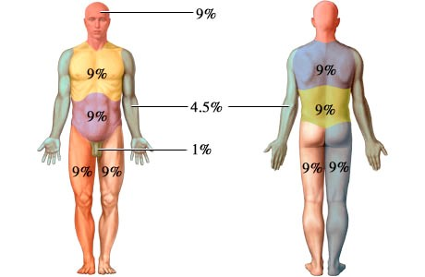
Assessment of burn wound
Total Body Surface Area (TBSA)
Estimating the total body surface area (TBSA) affected by the burn helps to determine the severity and guide treatment.
This is often done using:
Rule of Nines (for adults):
Head and neck: 9%
Each arm: 9%
Each leg: 18%
Front and back of the torso: 18% each
Perineum: 1%

Slide 101
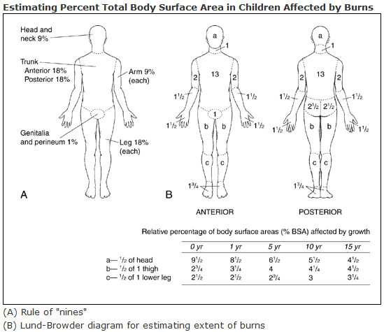
Cont…
Lund-Browder Chart (for children, as the body proportions differ from adults).The greater the TBSA involved, the more likely the patient will experience systemic complications like fluid loss, infection, and shock

Slide 102
severity classification og burns based on Tbsa
Total Burn Area and Severity:
Mild Burns:
<10% TBSA: Typically, first-degree and some second-degree burns.
Usually treated on an outpatient basis.
Moderate Burns:
10-20% TBSA: Often second-degree burns, can be treated in the hospital.
Risk for complications (fluid loss, infection), may need resuscitation.

Slide 103
Cont…
Severe Burns:
>20% TBSA: Involves deep second-degree or third-degree burns.
Requires intensive care and likely surgical intervention (skin grafts, debridement).
High risk of complications like shock, infection, and organ failure.
Critical Burns:
>30% TBSA: Life-threatening, often requires specialized burn unit care.
High mortality risk without proper treatment.

Slide 104
Burn location and its impact
Important Locations for Burn Severity:
Face, Hands, Feet, and Genitalia:
These areas are more functionally and aesthetically important.
Burns here may require reconstructive surgery and have a higher risk of long-term disability.
Functional Impact: Damage can impair mobility, breathing, and communication.
Aesthetic Impact: Scarring can significantly affect quality of life.

Slide 105
Cont…
Upper Chest and Neck:
Burns can lead to airway compromise and respiratory distress.
Risk of inhalation injury or eschar that restricts chest movement, affecting breathing.
Need for careful airway management.
Circumferential Burns:
Full-thickness burns around the torso or limbs can cause restriction of blood flow and movement.
Escharotomy may be needed to relieve pressure

Slide 106
Cont…
Pain and Symptom Assessment in Burn Injuries
Pain Level:
Burns are extremely painful due to nerve damage and inflammation.
First-degree: Mild to moderate pain.
Second-degree: Intense pain due to nerve involvement.
Third-degree and Fourth-degree: Minimal pain (nerve destruction).
Effective pain management is essential in the acute phase.

Slide 107
Cont…
Signs of Infection:
Symptoms: Increased redness, swelling, pus, fever, and a foul odor from the wound.
Infection risk is high due to the breakdown of the skin barrier.
Systemic signs of infection: Can lead to sepsis if untreated.

Slide 108
fluid management in burn patients
Fluid resuscitation is one of the cornerstones of burn care, particularly for patients with moderate to severe burns.
Adequate fluid management is essential to prevent hypovolemic shock, correct electrolyte imbalances, and support vital organ function during the early phase of burn recovery.

Slide 109
Cont…
Burn injuries result in fluid loss due to the destruction of the skin barrier, which leads to evaporative loss and plasma leakage into the interstitial space.
The loss of fluids, electrolytes, and proteins from the vasculature leads to hypovolemia, which must be corrected promptly

Slide 110
Cont…
Goals of Fluid Resuscitation:
Maintain adequate perfusion of vital organs (brain, kidneys, heart, etc.).
Restore intravascular volume to prevent shock.
Correct electrolyte imbalances (especially sodium and potassium).
Minimize complications, including kidney failure, cerebral edema, and metabolic derangements.

Slide 111
Fluid resuscitation formulae
The amount of fluid a burn patient requires is calculated based on the extent of burns (TBSA burned), the patient’s weight, and the time since the burn occurred.
The most commonly used formulas for burn fluid resuscitation are:
Parkland Formula (for adults)
Modified Brooke Formula (for adults)
Holliday-Segar Formula (for children)

Slide 112
1. Parkland formula ( for adults)
The Parkland formula is widely used to estimate the fluid needs for the first 24 hours after a burn injury.
Fluid Requirement (mL)=4×TBSA burned (%)×Weight (kg)
Example Calculation:
A 70 kg adult with 40% TBSA burns:
Fluid requirement = 4×40×70=11,200ml

Slide 113
Cont…
Half of this total amount is given during the first 8 hours post-burn, and the remaining half is given over the next 16 hours.
Fluid Type:
The Parkland formula typically uses lactated Ringer’s solution (LR) for the first 24 hours, as it is isotonic and closely matches the composition of extracellular fluid.

Slide 114
2. Modified brooke formula( for adults)
Another approach, which is slightly more conservative, suggests:
Fluid Requirement=2×TBSA burned (%)×Weight (kg)
Key Differences:
The modified Brooke formula uses half the fluid volume of the Parkland formula.
Also uses Lactated Ringer’s or normal saline for resuscitation.

Slide 115
3. Holliday-Segar Formula (for Children)
Used to calculate the maintenance fluid needs for children, not specifically for burn resuscitation but for general fluid needs, including in cases of burn injury.
Formula for Fluid Requirements (Maintenance):
For children weighing:
0–10 kg: 100 mL/kg/day
10–20 kg: 1,000 mL + 50 mL/kg for each kg over 10 kg
>20 kg: 1,500 mL + 20 mL/kg for each kg over 20 kg

Slide 116
Fluid Requirement for Burns:
When using the Holliday-Segar formula for burn patients, the general formula is adjusted to account for the TBSA burned:
Fluid Requirement=4 mL×TBSA burned (%)×Weight kg)
Key Features:
This formula also uses 4 mL per % TBSA burned but is typically used for children with burns.

Slide 117
Cont…
Fluid Type: Similar to the Parkland formula, Lactated Ringer’s is used for resuscitation.
Example:
A 10 kg child with 30% TBSA burns: Fluid requirement=4×30×10=1,200 mL(Total for 24 hours)\
First 8 hours: 600 mL
Next 16 hours: 600 mL

Slide 118
Fluid resuscitation protocols
First 24 Hours:
Initial Fluid Bolus: For patients with severe burns (>20% TBSA), a bolus of 500-1000 mL of Normal Saline or Ringer’s Lactate can be given immediately to stabilize the patient before starting the formal resuscitation formula.
Gradual Fluid Administration: Following the calculation using the Parkland formula or other methods, fluids are administered over 24 hours.

Slide 119
Cont…
Second 24 Hours and Beyond:
After the first 24 hours, fluid requirements decrease significantly.
The volume is tailored to urine output, vital signs, and clinical judgment.
A common goal for urine output is:
Adults: 0.5–1 mL/kg/hour.
Children: 1–2 mL/kg/hour.

Slide 120
Anaesthesia consideration
Anesthesia management for burn patients requires careful consideration due to the complex physiological changes that occur as a result of burns.
These changes affect almost every organ system, making anesthesia and perioperative care challenging.

Slide 121
1. Airway management
Risk of Airway Compromise:
Patients with burns to the face, neck, or chest may have significant risk of airway obstruction due to swelling, inhalation injury, or edema.
Intubation should be performed early
Airway management may require specialized techniques such as fiberoptic intubation or cricothyroidotomy if intubation is difficult.

Slide 122
Cont..
Inhalation Injury:
Inhalation of hot gases or chemicals can lead to airway edema, carbon monoxide poisoning, or cyanide toxicity.
Monitoring for signs of inhalation injury and ensuring proper ventilation and oxygenation is crucial.

Slide 123
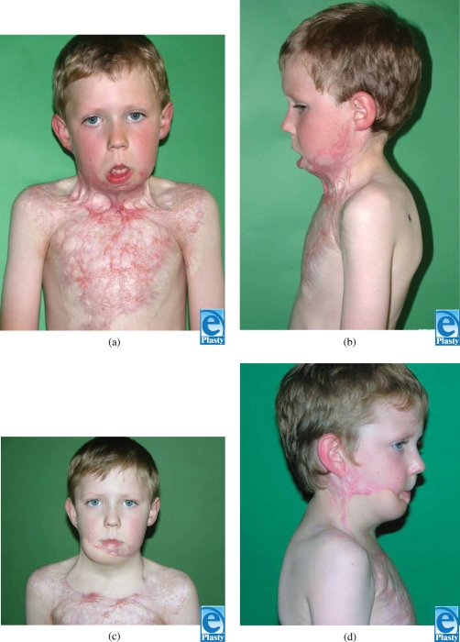

Slide 124
2. Fluid resuscitation
Burn Shock: Extensive burns cause a massive loss of fluids and electrolytes, leading to hypovolemic shock.
Fluid resuscitation is critical in the first 24 hours, and the most commonly used formula is the
Parkland formula (4 mL × body weight in kg × %TBSA burn).
Half of the fluid is given in the first 8 hours, and the remainder is given over the next 16 hours.

Slide 125
Cont..
Electrolyte Imbalance:
Burn patients often experience shifts in electrolytes (e.g., hypokalemia, hypernatremia) and require close monitoring and replacement of fluids and electrolytes.
3. Hemodynamic Considerations
Hypovolemia and Hypotension:
Initial hypovolemia due to fluid loss must be corrected quickly.

Slide 126
Cont..
Anesthesia providers should monitor blood pressure closely and use vasopressors (e.g., norepinephrine) if required.
Monitoring:
Invasive monitoring with a central venous catheter (CVC) or arterial line may be necessary to assess fluid status and guide resuscitation.

Slide 127
Thermoregulation:
Burn patients often have difficulty maintaining body temperature due to skin loss.
Warming measures, such as forced air warming blankets, should be used during surgery to prevent hypothermia

Slide 128
4. Medications and drug dosing
Pain Management:
Burn patients are at risk for severe pain.
Opioids (e.g., morphine, fentanyl) are commonly used for pain control, but due to altered pharmacokinetics, careful dosing and frequent reassessment are necessary.

Slide 129
Sedation and Anxiolysis:
Patients often require sedation for wound care or surgical procedures
Benzodiazepines and propofol can be used but require careful titration as burn patients may have altered responses to medications

Slide 130
Muscle relaxants
Burn patients may have altered sensitivity to muscle relaxants due to changes in protein binding and altered pharmacodynamics.
Burn injury–related changes cause proliferation of extrajunctional acetylcholine receptors that release more potassium into the extracellular space, predisposing to life-threatening hyperkalaemia when suxamethonium is used.
This risk appears to be greatest in patients more than 48 hours after and for up to 1 year postinjury

Slide 131
Cont…
Nondepolarising neuromuscular blocking agents (NMBAs) may also have altered pharmacodynamics in burn patients, and this is thought to be multifactorial.
An increased dose of rocuronium 1.2 to 1.5 mg/kg for rapid sequence induction is recommended, with effective paralysis time being approximately 90 seconds compared with 60 seconds in the nonburn population

Slide 132
Cont….
Plasma protein concentration and binding capabilities may be drastically altered after severe burn injury.
Significant hypoalbuminemia can occur due to protein-rich fluid loss and decreased hepatic synthesis.
In addition, alpha 1-acid glycoprotein (AAG) concentrations can increase as part of the inflammatory response following significant burn injury.

Slide 133
These can affect protein-bound anaesthetic and analgesic drugs.
Drugs bound to albumin may be present in a higher free concentration.
Conversely, drugs, such as local anaesthetics and analgesic agents, such as alfentanil, which are primarily bound to AAG, will have lower free concentrations than in the nonburn population
Pharmacodynamic changes may also arise as a result of continued exposure to opioid therapy for relief of sustained pain, resulting in opioid tolerance

Slide 134
Cont…
Antibiotics:
Burn patients are at high risk for infections, so prophylactic antibiotics may be given, especially in cases of deep or extensive burns.
5. Renal Function
Renal Perfusion and Function:
Hypovolemia and myoglobinuria from muscle damage (e.g., in cases of electrical burns) can lead to acute kidney injury (AKI).

Slide 135
Cont…
Monitoring renal function closely with serum creatinine and urine output is essential.
Early administration of fluids, mannitol, or sodium bicarbonate may help protect renal function.
6. Postoperative Care
Pain Management:
Due to the nature of the injuries, burn patients may require continuous pain management postoperatively.

Slide 136
Cont..
PCA (patient-controlled analgesia) with opioids, as well as adjuncts like nerve blocks or epidural anesthesia, can be considered for effective pain relief.
Wound Care:
Depending on the extent and type of burn, patients may undergo frequent dressing changes or surgeries for debridement, skin grafts, or reconstruction.
Anesthesia for these procedures must be carefully managed, with attention to fluid status, pain control, and infection prevention.

Slide 137
Vascular Access in burn pateints
Challenges: Significant fluid shifts and volume losses make vascular access critical but difficult.
Large-Bore Venous Lines: Essential for rapid fluid resuscitation and monitoring, especially in the first 24 hours.
Sites: Preferred sites are the upper extremities or central veins (e.g., internal jugular, subclavian).
Suturing vs. Adhesive: Suturing lines may be necessary instead of standard adhesive dressings to secure access.

Slide 138
The end

